Slide 1
PixyCam for MINDSTORMS Introduction

Slide 2
What is a PixyCam?
Vision system
Learns to detect objects that you teach it
Outputs what it detects 50 times per second
Connects directly to MINDSTORMS brick

Slide 3
Getting Started
Make sure you have updated your MINDSTORMS software and hardware
The minimum requirements are:
Software: 1.1.1
Firmware: 1.07H

Slide 4
Step 1: Install Software Blocks
Install all the Pixy EV3 blocks in the Mindstorms EV3 Software
This will allow you to use the camera in wait blocks, switches, loops, and more
Instructions:
Download the latest "LEGO blocks and examples" files from http://cmucam.org/projects/cmucam5/wiki/Latest_release
Unzip the zipped file
Open the LEGO MINSTORMS EV3 Software
Open a new Project
Select Tools → Block Import
Select the PixyCam blocks you downloaded and unzipped earlier
You will be asked to restart the EV3 Software after you import the blocks.

Slide 5
Step 2: Install PixyMon
This is software that lets you monitor the PixyCam. It is useful for the Step 3.
Mac: http://cmucam.org/projects/cmucam5/wiki/Install_PixyMon_on_Mac
Windows http://cmucam.org/projects/cmucam5/wiki/Install_PixyMon_on_Windows_Vista_7_8

Slide 6
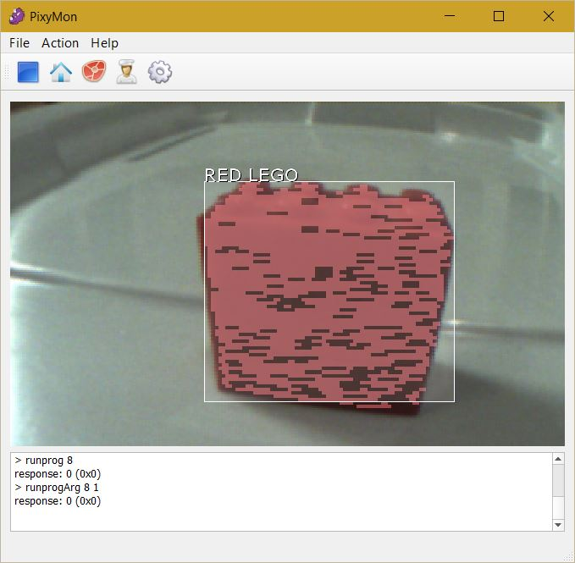
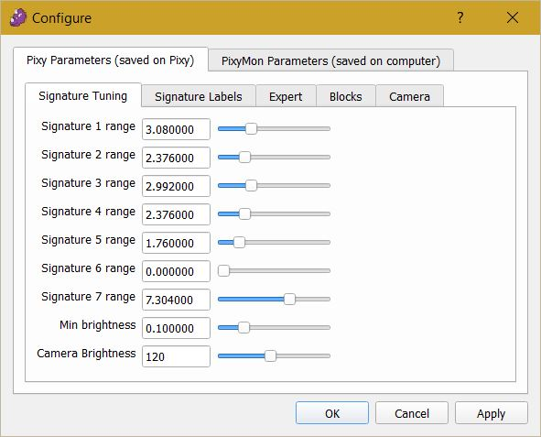
Step 3: Training the PixyCam with PixyMon
Tips:
Objects that are brightly colored work well. The camera uses color to detect the objects
Train the PixyCam on a plain background. Hardwood floors and carpet causes trouble.
A. Plug in the USB cable between the PixyCam and your computer and run PixyMon
B. Hold the object you want to teach in front of PixyCam lense and select Action → Set Signature 1 from the pulldown menu
C. Using the mouse, click and drag to select the region you want PixyCam to use to learn the object (make a box around the object)
D. Use the Configure screen to change the name (using Signature Labels) and use the Signature Tuning sliders until the object is well lit and completely highlighted (and nothing else is)

Slide 7
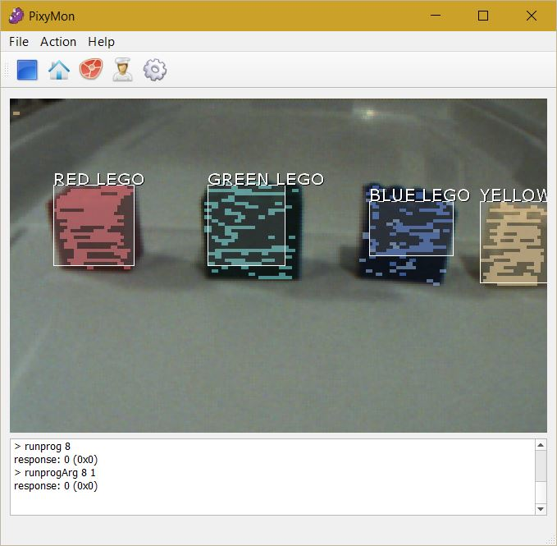
Challenge
Use PixyMon to recognize 4 different LEGO colors using LEGO bricks (Red, Green, Blue, Yellow).
Tune the signatures and rename them the correct color
You will be using these Signatures in the next lesson

Slide 8
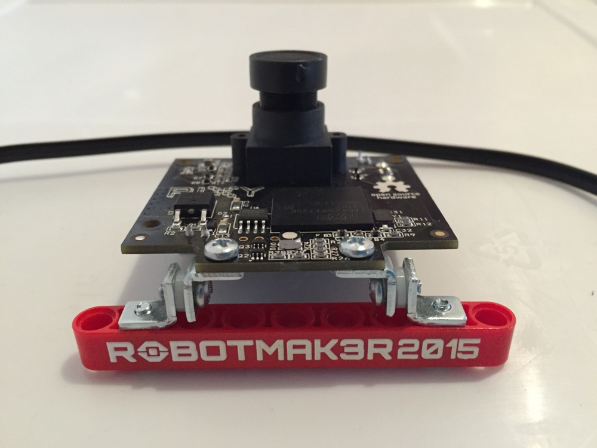
Step 4: Mounting the PixyCam
Add a LEGO beam to the PixyCam so that you can mount it on to your EV3 robot.
Instructions are here: http://cmucam.org/projects/cmucam5/wiki/Mounting_Pixy_with_LEGO
It should look like the image on the right in the end

Slide 9
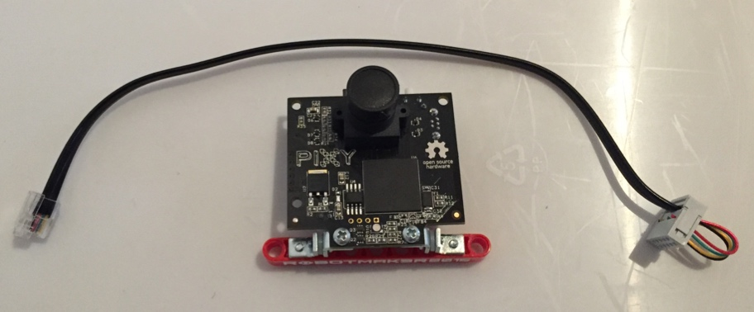
Step 5: Ready to Program
Connect your PixyCam to the EV3 brick using the cable provided
Turn on the EV3 and connect it to your computer
Move on to the next lesson.

Slide 10

CREDITS
This tutorial was created by Sanjay Seshan and Arvind Seshan from Droids Robotics.
More lessons are available at www.ev3lessons.com
Author’s Email: team@droidsrobotics.org
Thank you to Marc-André Bazergui for loaning us the PixyCam for this lesson, (https://www.facebook.com/marc.a.bazergui, info@bazmarc.ca)
This work is licensed under a Creative Commons Attribution-NonCommercial-ShareAlike 4.0 International License.

